Slide 1
Sales Analysis for the city
File created on: 1/28/2024 5:47:39 AM

Slide 2
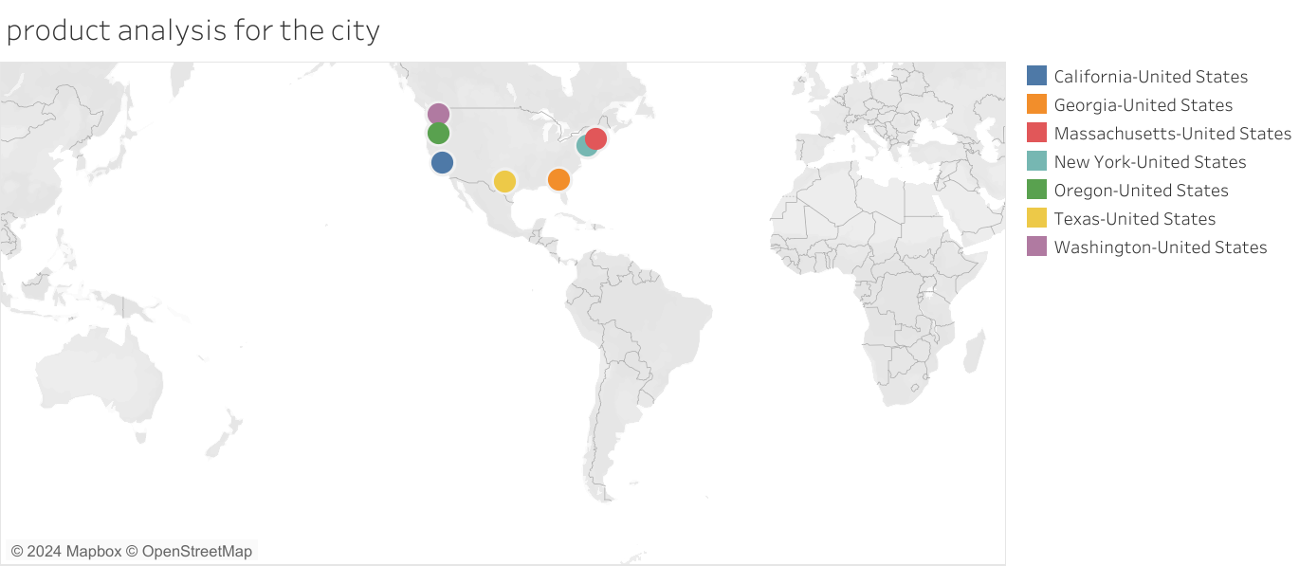

Slide 4
